Slide 1
A Concrete Truth: predicting concrete strength and carbon footprint
Daniel Freese & Konrad Genser

Slide 2

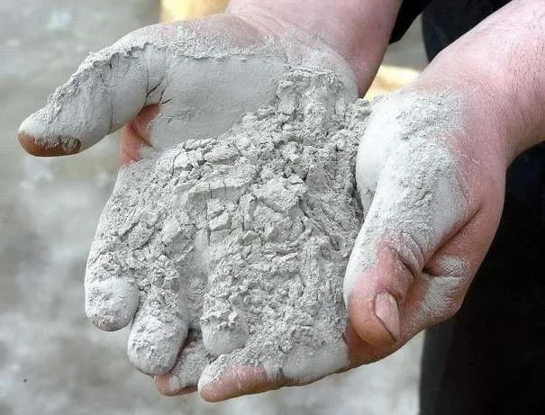

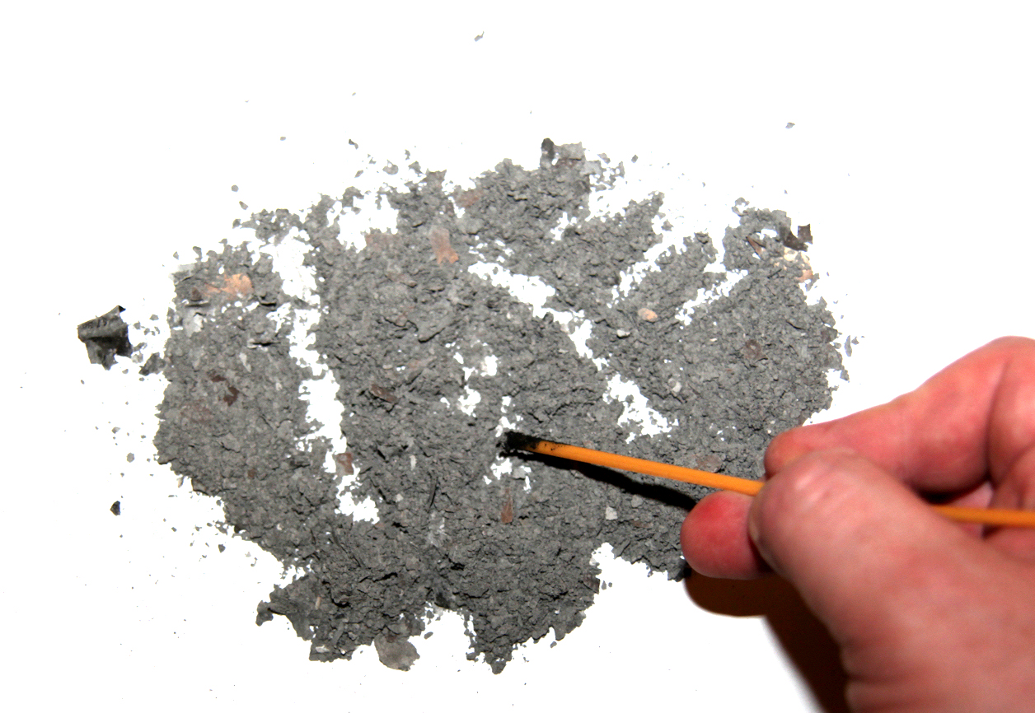

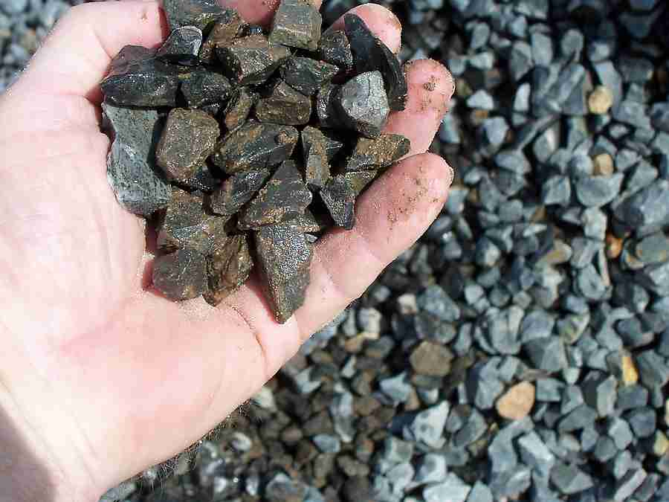
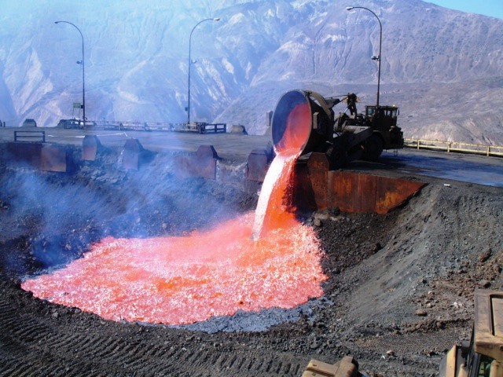

Concrete Data (from Kaggle)
Wait to Cure
Cement
Fine Aggregate
(Sand)
Ash
Industrial Waste
Filler
Superplasticizer
(Optional)
Water
Coarse Aggregate
Slag

Slide 3
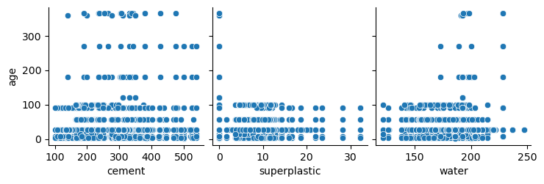
Outliers (age)

Slide 4
Different Models
Linear – plain and simple, baseline
Random Forest – Robust and usually works for interpolative
XGBoost – Random forest but better
Histogram-based Gradient Boosting Regression Tree – also robust
Neural Networks – Potential and seems like fun

Slide 6
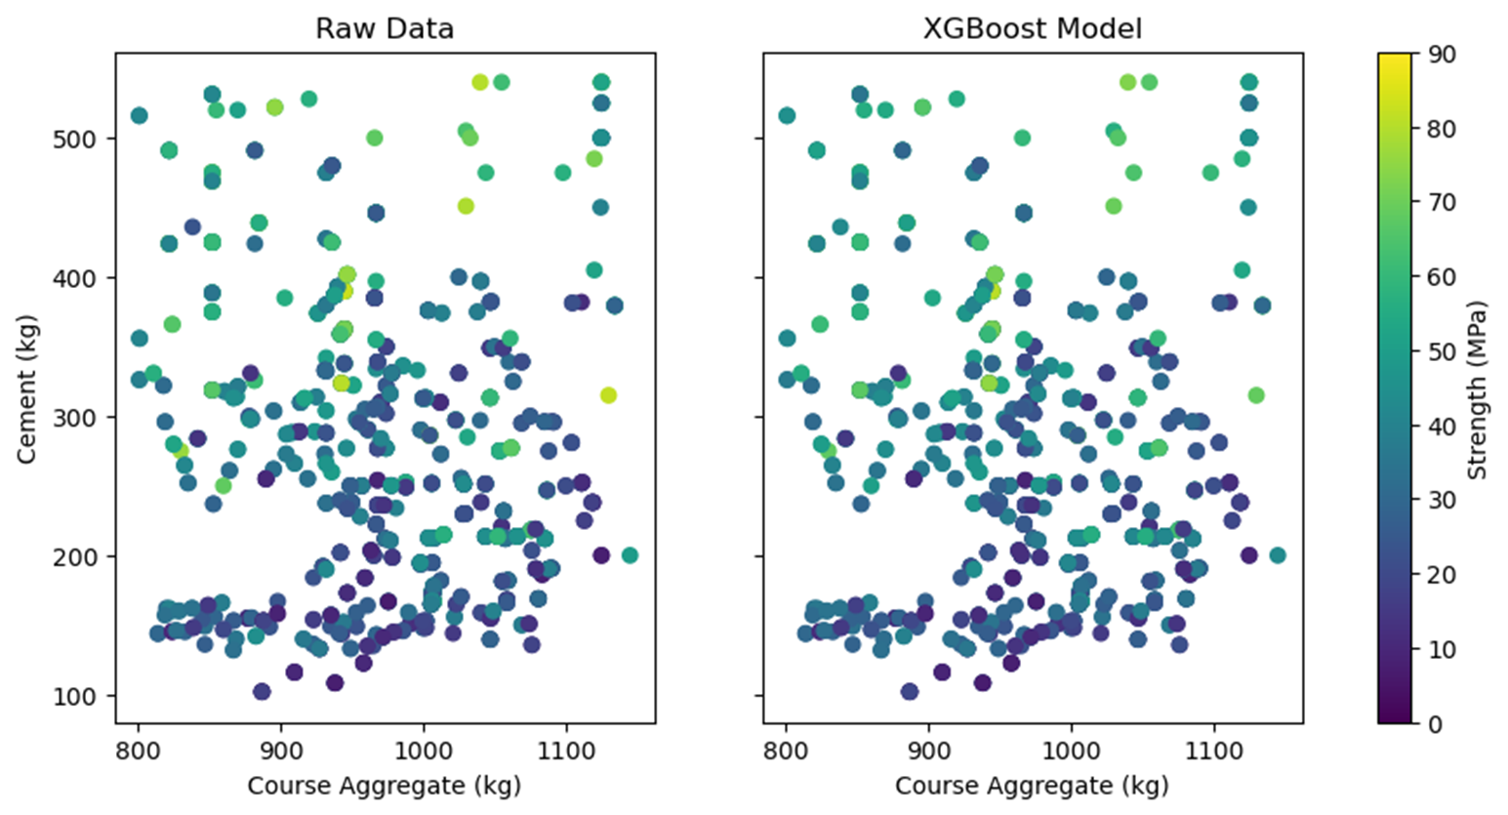
XGBoost Model comparison
Final Mean Squared Error: 18.9 (Mpa²)

Slide 7
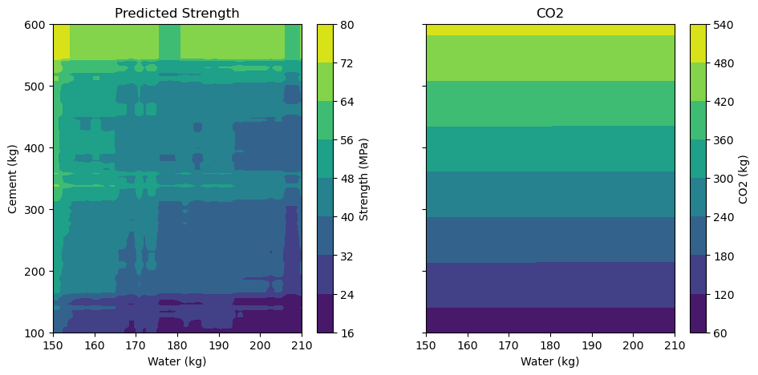
Carbon vs strength

Slide 8
Conclusion (if we had more time)
We have a model with decent accuracy within the parameters given
Analysis on ash and slag
More training time
Build an inverse function that takes strength and gives ingredients (minimize CO2, price)

